Slide 1
Stalking
Identification and Response
www.StalkingAwareness.org
Notes:
Key message: Introduction to the presentation
Welcome
My name is [name] and I’m [role].
Training created by the Stalking Prevention, Awareness and Resource Center (SPARC)– the only technical assistance provider on stalking.

Slide 2
Renee Sue O’Neal: Victim Statement
“Over and over and over again, for months, his goal was to terrorize me, and my whole family was victimized and fearful as a result… …I had no idea what his next move would be or when – not if – he would return.”
Smith, D. (2018, June 12). ‘He did not give up,’ murder victim said of ex who stalked, terrorized her. The Sacramento Bee.
Notes:
Key message: It is important to hear and learn directly from victims about their experiences.
Ask the group: Can someone read this quote out loud?
This is testimony from Renee Sue O’Neal, who was stalked by her ex-boyfriend, Jerrod Hill.
Renee was supposed to read these words from her victim statement as part of Jerrod’s sentencing hearing for a felony stalking charge. But she didn’t make it.
Jerrod – out on bail -- murdered her the morning of that hearing before killing himself.
Note to facilitator: You may wish to read more about this case prior to the training in case participants have questions. You can learn more here: https://www.sacbee.com/news/local/crime/article155772139.html).

Slide 3
Renee Sue O’Neal (1982 - 2017)
https://www.sacbee.com/news/local/crime/article155772139.html
Notes:
Key message: Renee’s story is just one example of the millions of people impacted by stalking, a serious and prevalent crime.

Slide 4
Stalking Prevalence and Risks
Over 25 million people have been stalked in the United States over the course of their lifetimes.
Smith, S.G, et al (2018). The National Intimate Partner and Sexual Violence Survey (NISVS) 2015 Data Brief. Atlanta, GA: Centers for Disease Control and Prevention
76% of femicide victims were stalked in the year prior to being murdered.
McFarlane et al., Stalking and Intimate Partner Femicide, 3(4) Homicide Studies 300-16 (1999).
Notes:
Key message: Stalking is prevalent and dangerous.
An estimated 25 million people have been stalked in the United States over the course of their lifetimes.
6-7.5 million are stalked in a one-year period.
Stalking is a major predictor of lethality:
In one study, 76% of femicide victims murdered by intimate partners were stalked prior to being killed.
Yet, very few stalkers are charged, arrested or prosecuted.

Slide 5
Today’s Objectives
By the end of today’s workshop, participants will be able to:
Identify stalking behaviors and dynamics
Recognize the intersection of stalking with other crimes
Apply strategies for working with victims of stalking
Notes:
Key message: Today, you’ll leave with a stronger understanding of stalking as well as practical tools and strategies to identify and respond to stalking cases in our community.
Stalking is a serious and often overlooked crime that impacts men and women in every community.

Slide 6
Session Overview
Defining Stalking
Identifying a Pattern of Behavior
Prevalence, Dynamics and Behaviors
Co-occurrence with Other Crimes
Notes:
Key message: Today, we’ll be focusing on the dynamics and prevalence of stalking.
We’ll cover:
Defining Stalking
Identifying a Pattern of Behavior
Prevalence, Dynamics and Behaviors
Co-occurrence with Other Crimes

Slide 7
Defining Stalking
Notes:
Key message: To ensure we have a common understanding of what stalking is (and is not), we’ll start by defining stalking.

Slide 8
Stalking is a Crime
Federal
All 50 States; District of Columbia; U.S. Territories
Uniform Code of Military Justice
Tribal Codes
Notes:
Key message: Stalking is a crime across the United States.
Stalking is a crime in all 50 states, the District of Columbia and U.S. territories.
There is a Federal statute as well.
Many tribal codes criminalize stalking.
The military justice system also has codes on stalking.
{Note to Facilitator: Visit the SPARC website and/or contact SPARC for your state’s laws and an explanation of those laws).

Slide 9
Behavioral Definition
Stalking:
A pattern of behavior directed at a specific person that would cause a reasonable person to feel fear.
Notes:
Key message: The behavioral definition of stalking is a pattern of behavior directed at a specific person that would cause a reasonable person to feel fear.
Understanding stalking from a behavioral perspective is important.
This is the behavioral definition.
Can someone read this definition out loud for me?

Slide 10
Behavioral Definition
Stalking:
A pattern of behavior directed at a specific person that would cause a reasonable person to feel fear.
Notes:
Key message: We’ll discuss the highlighted elements in more detail.
Some of the important concepts here have been highlighted.
Let’s break this down.

Slide 11
A Pattern of Behavior…
Not a single incident or “one off” event
Called a “course of conduct” in most stalking statutes
Notes:
Key message: Stalking is a pattern of behavior that requires 2 or more behaviors. The behaviors can vary or be the same. Some behaviors are criminal on their own (like property damage) while others only become criminal when part of a stalking case (like excessive texting).
Like domestic violence, stalking is NOT just one incident. It is a pattern.
Ask the group: How many times does something have to happen for it to be a pattern? (Answer: 2-3)
Does the behavior have to be the same every time (for example, calling every day) or can the behaviors be different? (Answer: Behaviors can be different – like calling one day and then sending a gift the next week)
When you’re looking at the stalking statute, realize that most legal definitions of stalking use the term “course of conduct.” This is a synonym for “pattern of behavior.”
Many different behaviors can be part of a stalking pattern/course of conduct.
Some stalking behaviors are criminal (for example, property damage).
Others are not crimes on their own (for example, sending gifts), but can become criminal when part of a stalking course of conduct.

Slide 12
…Directed at a Specific Person…
Notes:
Key message: Stalking is directed at a specific person.
Stalking is directed at a specific individual, not a group.
However, stalkers may target other people close to the primary victim – like family members or a new boyfriend or girlfriend.

Slide 13
…That would cause a Reasonable Person to Feel Fear.
Notes:
Key message: Fear is key to the definition of stalking.
The reasonable person standard asks us to consider how any rational person in similar circumstances to the victim might feel.
Fear is key to the definition of stalking.
Fear is how we differentiate stalking from other crimes, like harassment.
Harassment generally describes behavior that is irritating, while stalking describes behaviors that cause fear.

Slide 14
What’s so Scary?
Notes:
Key message: Context is critical to understanding fear.
Context is everything in stalking cases.
Note to facilitator: You may wish to replace the example story below with one from a case you’ve worked on.
Consider this story:
A woman hysterically called the police.
When they finally got her to explain, she said “there’s a cup of coffee in my car.”
Understandably, the department did not see this as an urgent call.
Eventually, she said – “he’s here.”
It turns out she was a stalking victim who had relocated and did not believe her stalker knew where she was. That morning, she found a cup of coffee in her car with his nickname for her on it.

Slide 15
Context is Critical
Something may be frightening to the victim but not to you
Stalking behaviors often have specific meanings known only to the victim and the stalker
Stalking criminalizes otherwise non-criminal behavior
Notes:
Key message: Context is critical in stalking cases. Something may be frightening to the victim but not to you as the responder.
Something may be frightening to the victim but not to you as the responder.
Stalking behaviors often have specific meaning that may only be understood between offender and victim.
If the cause for fear is not intuitive, it’s essential to ask victims “Why did that scare you?”
Stalking criminalizes otherwise non-criminal behavior.
It’s not illegal to text someone, or send a gift or to ring their doorbell – unless it’s part of a stalking course of conduct.

Slide 16
What Might Stalkers Say?
I love you
I miss you
Please be with me
You b****
I hate you
I’ll kill you
Notes:
Key message: Stalking can sound very different depending on the context and the specific stalking situation.
Stalkers use different approaches.
Some may seem benign or even sweet to an outsider.
They may also be threatening.
Again, context is key to understanding why a stalker’s behavior is scary to a victim.

Slide 17
Victim Responses: Is it Fear?
Notes:
Key message: Victims may not present as fearful and/or admit that they are experiencing fear.
Often, victims may express emotions or reactions other than fear.
Some victims may not ever express fear:
They may express anger, irritation and/or exhaustion.
Others may show no affect.
Many victims minimize what’s going on as a way to cope.
Many people do not feel comfortable expressing that they feel afraid.
This can be especially true for victims who might feel like they have to “stay tough” or “be strong.”
To better understand the impact that stalking is having on a victim, ask questions about what the victim has changed as a response to the stalking.
For example, did they move? Change routes to and from their work or school? These imply fear.

Slide 18
“Going to work, attending your kids activities, going out for the evening… these things seem routine.
For me, they’re terrifying because I never know what he will do or when he will show up.”
--Stalking Survivor
Notes:
Key message: It’s important to hear from victims in their own words.
Stalking can include physical danger as well as psychological harm.
This is a quote from a survivor of stalking that illustrates emotional impact and fear.

Slide 19
Identifying a Course of Conduct
Stalking Behaviors
Notes:
Key message: Now that we’ve defined stalking, we’re going to discuss the different behaviors that stalkers may engage in.

Slide 20
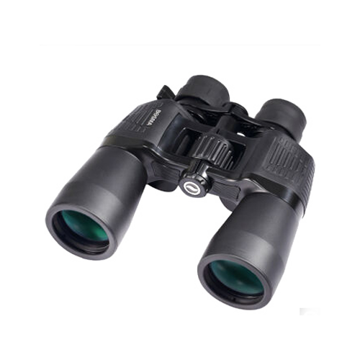
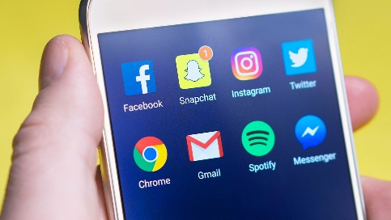
Identifying Course of Conduct
S L I I
Surveillance
Life Invasion
Interference
Intimidation
Logan, T.K. & Walker, R. (2017). Stalking: A Multidimensional Framework for Assessment and Safety Planning, Trauma, Violence and Abuse 18(2), 200-222.
Notes:
Key message: Stalkers use many methods and strategies to stalk their victims. One significant stalking researcher, developed the helpful acronym S-L-I-I to categorize the different methods.
Stalkers use many strategies to stalk their victims. The acronym S-L-I-I can help you remember the different methods.
Many of the categories intersect and overlap.
The categories are:
Surveillance: How is the stalker tracking or monitoring the victim?
Life invasion: How has the stalker invaded the victim’s life?
Interference: What has the victim lost and/or what is s/he afraid of losing because of the stalker?
Intimidation: How has the stalker intimidated or threatened the victim?

Slide 21
Group Activity
SLII Brainstorm
Notes:
Optional activity.
Note to facilitator: Split the room into small groups and assign each group one of the types of strategies (surveillance, life invasion, interference or intimidation). Depending on your audience size, you may have more than one small group discuss the same topic. Allow up to 5 minutes for groups to brainstorm stalking strategies that reflect the category. Then, report out.
The training speaker notes includes a sample handout for this exercise or you can distribute large pieces of paper and markers for each group to write their responses on.
You may wish to record their responses on your own flip chart/white board when groups report out.

Slide 22
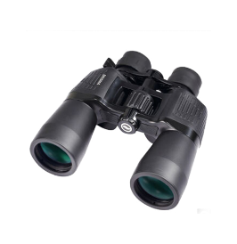
SLII Examples
Surveillance
Life Invasion
Follow
Watch
Wait
Show up
Tracking software
Obtain information about victim
Proxy stalking
Unwanted contact at home, work, etc.
Phone calls
Property invasion
Public humiliation
Harass friends/family
Notes:
Key message: These are examples of surveillance and life invasion.
Thank you for that brainstorm.
Here are some examples of the types of stalking behaviors.
Many of these behaviors are not criminal on their own and may seem innocuous to an outsider who doesn’t understand the context.
(Note to Facilitator: Point out any that the participants may have missed. Below are some points on terms or strategies)
Surveillance:
Behaviors including watching, following and tracking
Many stalkers use technology to enhance their surveillance (like GPS devices).
Life invasion:
Behaviors include unwanted contact or showing up at work, at home or wherever the victim may be.

Slide 23
SLII Examples
Cont’d
Interference
Intimidation
Financial and work sabotage
Ruining reputation
Custody interference
Keep from leaving
Road rage
Attack family/friends
Physical/sexual attack
Threats
Property damage
Forced confrontations
Threaten or actually harm self
Threats to victim about harming others
Notes:
Key message: These are examples of interference and intimidation.
Interference includes physical violence as well as ruining the victim’s reputation and/or financial or work sabotage.
Intimidation may include threats, confrontations and violence to self, the victim or others.

Slide 24
Stalking Behaviors
Stalking Victimization in the United States, BJS (2009)
Notes:
Key message: The most common stalking behaviors are unwanted contact, spreading rumors, following and spying.
Here are the most common stalking behaviors.
2/3 of stalkers send unwanted text messages and make unwanted phone calls.
About a third spread rumors, follow/spy, send unwanted letters and email and show up at places.

Slide 25
Stalking behaviors often change over time.
Notes:
Key message: Stalking behaviors change over time.
Stalkers are likely to change their tactics as the victim responds (or does not respond) to their behaviors.
For example, if a victim stops answering his or her phone, the stalker may begin showing up in person.
Stalking can escalate very quickly.

Slide 26
Multiple Behaviors
78% of stalkers use more than one means of approach
66% of stalkers pursue their victim at least once per week
20% of stalkers use weapons to threaten or harm victims
Mohandie, K., Meloy, J.R., McGowan, M.G., & Williams, J. (2006). The RECON Typology of Stalking: Reliability and Validity Based upon a Large Sample of North American Stalkers. Journal of Forensic Sciences, 51 (1), 147-155.
Notes:
Key message: Stalkers often engage in multiple behaviors.
78% of stalkers use more than one means of approach.
66% of stalkers pursue their victim at least once per week.
20% of stalkers use weapons to threaten or harm victims.
Knives are the most common weapon that stalkers use – it’s more intimate.

Slide 27
Prevalence and Perpetrators
Notes:
Key message: Now that we’ve built an understanding of stalking behaviors, let’s discuss the prevalence and dynamics.

Slide 28
Prevalence of Stalking
WOMEN
MEN
1 year period: nearly 2 million
1 year period: more than 4 million
6- 7.5 million people are stalked in a one year period in the United States.
Smith, S.G., Zhang, X., Basile, K.C., Merrick, M.T., Wang, J., Kresnow, M., & Chen, J. (2018). The National Intimate Partner and Sexual Violence Survey (NISVS): 2015 Data Brief. Atlanta, GA: National Center for Injury Prevention and Control, Centers for Disease Control and Prevention.
Notes:
Key message: An estimated 6 - 7.5 million people are stalked in a one year period in the United States.
Stalking is a very prevalent crime.
Between 6 and 7.5 million people are stalked in a one year period in the United States.

Slide 29
Prevalence in a Lifetime
More than 1 in 6
WOMEN
More than 1 in 17
MEN
Smith, S.G., Zhang, X., Basile, K.C., Merrick, M.T., Wang, J., Kresnow, M., & Chen, J. (2018). The National Intimate Partner and Sexual Violence Survey (NISVS): 2015 Data Brief. Atlanta, GA: National Center for Injury Prevention and Control, Centers for Disease Control and Prevention.
Notes:
Key message: More than 1 in 6 women and 1 in 17 men have experienced stalking.
This breaks down to more than 1 in 6 women and 1 in 17 men experiencing stalking over their lifetime.
The rates for domestic violence are around 1 in 4 – not that different.
However, the level of response to stalking has been far less.

Slide 30
Victims
Women are more likely than men to experience stalking.
Smith, S.G., Zhang, X., Basile, K.C., Merrick, M.T., Wang, J., Kresnow, M., & Chen, J. (2018). The National Intimate Partner and Sexual Violence Survey (NISVS): 2015 Data Brief. Atlanta, GA: National Center for Injury Prevention and Control, Centers for Disease Control and Prevention.
Notes:
Key message: While people of all genders can experience stalking, women are more likely than men to experience stalking.

Slide 31
Stalking Risk
18-24 year olds experience the highest rates of stalking (among adults).
Smith, S.G., Zhang, X., Basile, K.C., Merrick, M.T., Wang, J., Kresnow, M., & Chen, J. (2018). The National Intimate Partner and Sexual Violence Survey (NISVS): 2015 Data Brief. Atlanta, GA: National Center for Injury Prevention and Control, Centers for Disease Control and Prevention.
Notes:
Key message: 18-24 year olds experience the highest rates of stalking
Stalking impacts people of all ages – from children to older adults.
18-24 year olds experience the highest rates of stalking.
Ask the group: Why do you think this is?
A few reasons may be:
Young people are still developing impulse control.
Many people in this age group live on college campuses, where the geographic proximity makes stalking easy for a perpetrator
Young people have fewer experiences with sexual/romantic relationships and manners of responding to when those relationships end.

Slide 32
Perpetrators
The majority of stalking victims reported that the perpetrator was male.
Black, M.C., Basile, K.C., Breiding, M.J., Smith, S.G., Walters, M.L., Merrick, M.T., Chen, J. & Stevens, M.R. (2011). The National Intimate Partner and Sexual Violence Survey (NISVS): 2010 Summary Report. Atlanta, GA: National Center for Injury Prevention and Control, Centers for Disease Control and Prevention.
Notes:
Key message: Most stalkers are male.
While there are offenders of all genders, the majority of victims report that their stalkers are male.
When the victim is male, the offender is also male about half the time.
Often, the stalker is stalking a former intimate partner and targets the new boyfriend as well.

Slide 33
Relationships
The majority of the time, the victim knows the perpetrator.
Black, M.C., Basile, K.C., Breiding, M.J., Smith, S.G., Walters, M.L., Merrick, M.T., Chen, J. & Stevens, M.R. (2011). The National Intimate Partner and Sexual Violence Survey (NISVS): 2010 Summary Report. Atlanta, GA: National Center for Injury Prevention and Control, Centers for Disease Control and Prevention.
Notes:
Key message: The victim knows the perpetrator the vast majority of the time.
In popular culture, when we hear “stalking” we may think about celebrity stalkers.
While this can happen, the victim knows the perpetrator the vast majority of the time.

Slide 34
Victim and Offender Relationships
Smith, S.G., Chen, J., Basile, K.C., Gilbert, L.K., Merrick, M.T., Patel, N., Walling, M., & Jain, A. (2017). The National Intimate Partner and Sexual Violence Survey (NISVS): 2010-2012 State Report. Atlanta, GA: National Center for Injury Prevention and Control, Centers for Disease Control and Prevention. Retrieved from https://www.cdc.gov/violenceprevention/pdf/NISVS-StateReportBook.pdf
Notes:
Key message: Most offenders are known to their victim in some capacity – most often former/current intimate partners. Strangers only account for a minority of the cases.
The majority of stalkers are intimate partners (current or former)
Stalking is a method of exerting power and control in an abusive relationship.
It is also essential to realize that many stalkers are NOT intimate partners.
Particularly for male victims, the stalker is often an acquaintance.
Stalking is often categorized under domestic violence.
But it’s essential to realize that not all stalking is related to domestic violence.
All stalking victims need our help and our response.

Slide 35
Why Do They Stalk?
Seeking Affection
Power & Control
Planning to commit a crime
Rejection
Obsession
Because they can
Notes:
Key message: There are multiple reasons why a stalker may perpetrate this crime. Often, stalkers stalk because they can.
Stalkers have different motivations. These can include:
Seeking affection
Power and control (as an extension of an abusive relationship)
Rejection, leading to stalking as retaliation
Obsession
Planning to commit a crime (for example, rapists may learn a victim’s habits and schedule to more easily target him or her)
Because they can. Stalkers often get away with stalking.

Slide 36
Co-Occurring Crimes
Notes:
Key message: Stalking often co-occurs with other crimes.

Slide 37
Co-Occurring Crimes with Stalking Cases
24% involve property damage
21% involve a direct attack on the victim
15% involve an attack on another person or pet
Baum, K., Catalano, S., & Rand, M. (2009). Stalking Victimization in the United States. Washington, DC: Bureau of Justice Statistics. Retrieved from https://www.justice.gov/sites/default/files/ovw/legacy/2012/08/15/bjs-stalking-rpt.pdf.
Notes:
Key message: Stalking cases often involve crimes such as property damage and/or assault on the victim.
Nearly ¼ cases involve property damage.
Over 1/5 involve a direct attack on the victim
15% involve an attack on another person or a pet.

Slide 38
Identity Theft
Baum, K., Catalano, S., & Rand, M. (2009). Stalking Victimization in the United States. Washington, DC: Bureau of Justice Statistics. Retrieved from https://www.justice.gov/sites/default/files/ovw/legacy/2012/08/15/bjs-stalking-rpt.pdf.
Notes:
Key message: A stalker often has the information needed to steal the victim’s identity. Many stalkers access a victim’s financial accounts.
Stalkers also often access a victim’s financial accounts
Even if a victim changes his or her passwords, usually the “reset your password” questions ask for personal information that the stalker is likely to know (like Mother’s maiden name, city born).
You may suggest that victims enter false information for their security questions, perhaps using the same answer for everything (like the word “blue”).

Slide 39
Stalking and Domestic Violence
Notes:
Key message: Stalking often co-occurs with domestic violence.
As stated before, over half of stalking cases involve intimate partner stalkers.

Slide 40
Point When Stalking Occurs
Tjaden, P. & Thoennes, N. (1998). Stalking in America: Findings from the national violence against women survey (NCJ#169592). Washington, DC: National Institute of Justice Centers for Disease Control and Prevention. Retrieved from https://www.ncjrs.gov/pdffiles/169592.pdf.
Notes:
Key message: Stalking may occur during an abusive relationship, after the relationship ends or both.
Often, victims and service providers do not identify the behavior as “stalking” when it happens during a relationship.
The constant contact, surveillance and threats that may be part of an abusive relationship are also stalking behaviors.
Stalking may occur during an abusive relationship or begin after the relationship has ended.

Slide 41
On average, intimate partner stalkers pose the greatest threats to their victims.
Notes:
Key message: Intimate partner stalkers pose the greatest threats to their victims.
Ask the group: Why do you think this is? Why might an intimate partner make for a particularly dangerous stalker? (Sample answers: they know the victim the best – the victim’s schedule, social network, even accounts and passwords. They know the victim well and how best to upset them).

Slide 42
Intimate Partner Stalkers Increased Risk for Victims
More likely to physically approach victim
More insulting, interfering and threatening
More likely to use weapons
Behaviors more likely to escalate quickly
More likely to re-offend
Mohandie, K., Meloy, J.R., McGowan, M.G., & Williams, J. (2006). The RECON Typology of Stalking: Reliability and Validity Based upon a Large Sample of North American Stalkers. Journal of Forensic Sciences, 51 (1), 147-155.
Notes:
Key message: Intimate partners are more likely to engage in a variety of threatening and harmful behaviors than non-intimate-partner stalkers.
Intimate partner stalkers are more likely to:
Physically approach the victim
Use weapons
Escalate behaviors
Re-offend

Slide 43
}
Physical Abuse
Greater risk of lethality than either behavior alone.
Stalking
Notes:
Key message: When there’s both physical abuse and stalking, the victim is at a higher lethality risk than for either behavior alone.
Where there is evidence of the presence of jealousy, direct threats and illegal drug use, the risk of stalking violence is heightened.

Slide 44
Lethality Risks
76%
At LEAST 1 episode of stalking within year prior to murder
85%
At LEAST 1 episode of stalking within year prior to attempted murder
Attempted femicide by intimate partner
Femicide by intimate partner
McFarlane, J., Campbell, J.C., Wilt, S., Ulrich, Y., & Xu, X. (1999.) Stalking and Intimate Partner Femicide. Homicide Studies 3 (4), 300-316. Retrieved from http://ncdsv.org/images/HomicideStudies_StalkingAndIntimatePartnerFemicide_11-1999.pdf.
Notes:
Key message: Stalking is a major predictor of femicide.
One study found that, when the perpetrator was an intimate partner, there was at least one stalking incident the year prior in:
76% of femicide cases
85% of attempted femicide cases.

Slide 45
Stalking and Sexual Violence
Notes:
Key message: Stalking may also intersect with sexual violence.

Slide 46
Intersections of Sexual Violence and Stalking
A stalker may:
Threaten to sexually assault the victim
Sexually assault the victim
Attempt to get someone else to sexually assault the victim
Notes:
Key message: Stalking may intersect with sexual violence in a variety of ways.
A stalker may:
Threaten to sexually assault the victim.
Sexually assault the victim.
Or attempt to get someone else to sexually assault the victim.
For intimate partner stalkers, sexual abuse is often part of an abusive relationship that includes stalking.

Slide 47
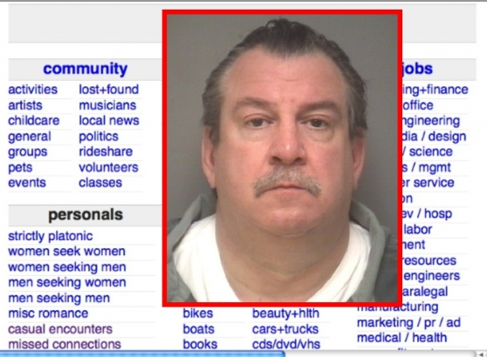
Craigslist Case
Kenneth Kuban posted at least 165 ads in Craigslist "casual encounters" section posing as his ex-girlfriend.
Notes:
Key message: This is an example case in which a stalker impersonated his victim on Craigslist to try and facilitate sexual assault.
In this Craigslist case, a man posted over 165 fake sex ads pretending to be his ex-girlfriend.
He shared her address and pretended to be her.
More than 100 men appeared at or around the victim’s home over a few months, propositioning her for sex.
There are multiple cases in which stalkers impersonate their victims online to arrange sexual assault.

Slide 48
Grooming for Sexual Assault as Stalking
6% of the 1882 college men surveyed met the criteria for attempted or completed rape
These were repeat perpetrators who averaged about 6 rapes per person
Lisak, D & Miller, P. (2002). Repeat Rape and Multiple Offending Among Undetected Rapists. Violence and Victims 17 (1), 73-84. Retrieved from https://www.davidlisak.com/wp-content/uploads/pdf/RepeatRapeinUndetectedRapists.pdf.
Notes:
Key message: The way that repeat rape perpetrators groom victims for sexual assault can also be stalking. David Lisak’s research on repeat perpetrators on campus found that repeat rapists engaged in a premeditated plan to target victims and commit assault.
In an influential study of rape on college campuses, research David Lisak found that many rapes were committed be repeat perpetrators.
These perpetrators committed an average of about 6 rapes each.
These rapes were premeditated.

Slide 49
Repeat Campus Sexual Assault Perpetrators Often Premeditated Rape
Chose targets intentionally. Identified vulnerable young women, often focusing on Freshmen
Contacted multiple times: invited them to parties, messaged through social media, texting and call.
Plied with alcohol: served drinks, controlled alcohol, made strong drinks
Isolated victims: many had rooms set up at their parties for the purpose of committing rape
Contacted after: texted, messaged and/or called to either threaten and/or invite to another party
Lisak, D & Miller, P. (2002). Repeat Rape and Multiple Offending Among Undetected Rapists. Violence and Victims 17 (1), 73-84. Retrieved from https://www.davidlisak.com/wp-content/uploads/pdf/RepeatRapeinUndetectedRapists.pdf.
Notes:
Key message: The repeated contact directed at specific targets that these perpetrators engaged in can also be considered stalking.
These repeat rapists:
Chose targets intentionally, focusing on the youngest and most vulnerable women – often Freshmen
Contacted them multiple times prior to the assault (inviting them, complimenting them, building rapport)
When at the party, they plied victims with alcohol
They then isolated the victims, often taken them to rooms set up with the intention of committing these assaults
Many times, rapists contact their victims after
They may invite them to another party, thank them for a good time or even threaten them
Consider these behaviors through a stalking lens. Could this premeditation and contact after be stalking?
Remember, fear can attach at any time in a stalking case.
Perhaps a victim was not afraid when first invited to the party – but looking back on the whole experience, she may now feel fear.

Slide 50
Addressing Stalking
Notes:
Key message: Here are some basic tools and information that you can use to start improving your response to stalking.
It is essential to support victims as well as hold offenders accountable for stalking.
There is more information on the SPARC website about how to best do so.

Slide 51
Documentation
Notes:
Key message: Documentation is essential for all stalking behaviors.
Victims should keep records of all of the behaviors that they experience -- criminal or not.
Ask the group: Why is documentation important?
(Answers: record for police and legal proceedings, can help victim recognize the extent of their victimization)

Slide 52
Documentation Log
Notes:
Key message: This stalking documentation log is a very helpful tool that is available on the SPARC website.
This stalking documentation log is available for download on the SPARC website.
The location of incident, police report and badge numbers are essential.
Stalking crosses jurisdictional boundaries.
Often, victims feel frustrated that the person they report to may not have a record of past complaints.
Omit how the incident made the victim feel.
Stalker may have access to this log during prosecution.

Slide 53
Safety Planning
Consider:
The possibility of escalation
The variety of behaviors a stalker may engage in
Maintaining contact may be a part of a safety plan
Notes:
Key message: When safety planning for stalking, we must consider the variety of behaviors that a stalker may engage in and recognize that stalkers are likely to escalate and/or change their tactics.
Often – as advocates and/or law enforcement – we focus on the incident(s) that we know about and plan and/or respond to just those incidents.
Safety planning for stalking should:
Consider the possibility of escalation.
Stalking can escalate quickly.
When a victim reacts to the stalking – for example, by getting an order of protection – the stalker may escalate their behavior.
Stalkers may begin new behaviors at any time.
Talking to victims about the SLII behaviors may provide you with more information as well as help them prepare for a stalker’s next move.
Victims may need to maintain contact with their stalkers for their own safety.
For example, victims may know that if they answer the phone, the stalker is less likely to come to their home.

Slide 54
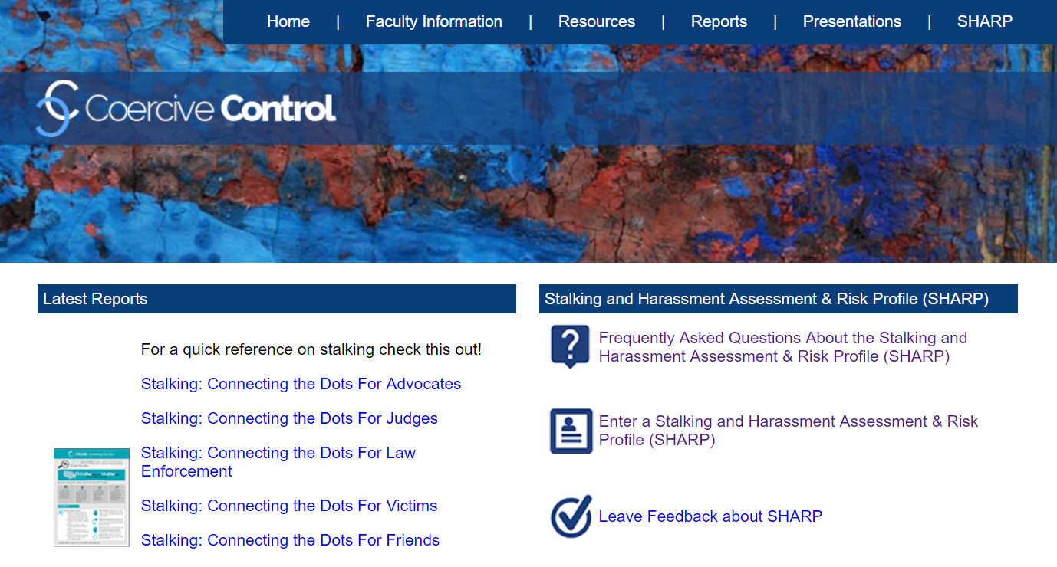
SHARP Assessment
www.coercivecontrol.org
Notes:
Key message: SHARP is a free online danger assessment tool that is specific to stalking.
SHARP is a danger assessment that focuses on stalking specifically rather than IPV or SA.
Free to use online at www.coercivecontrol.com and provides a narrative report as well as an assessment of risk.
Victim advocate or law enforcement can complete with the victim.

Slide 55
The threat level is never fixed. Risks change over time and must be constantly assessed.
Notes:
Key message: Threat assessments only capture a moment in time – we must constantly assess threats.
SHARP is a good tool, but any threat assessment is only measuring risk at a certain point in time.
We can never use risk assessment to determine that a person is not a risk!
Threat level NEVER fixed—can change over time.
Constant assessment of threat is a MUST.

Slide 56
Conclusion
Notes:
Key message: Let’s summarize what we learned today.

Slide 57
Conclusion
Stalking is defined as a course of conduct directed at a specific person that would cause a reasonable person to feel fear
Context is critical in stalking cases
Stalking behaviors include Surveillance, Life Invasion, Interference and Intimidation (SLII)
The majority of stalkers and victims know each other.
Stalking intersects with other crimes including domestic and sexual violence
There are tools you can use to improve your response to stalking
Notes:
Key message: Reviewing what we learned today.
Stalking is defined as a course of conduct directed at a specific person that would cause a reasonable person to feel fear.
Context is critical in stalking cases.
Stalking behaviors include Surveillance, Life Invasion, Interference and Intimidation (SLII).
The majority of stalkers and victims know each other.
Stalking intersects with other crimes including domestic and sexual violence.

Slide 58
More Lessons Coming Soon! www.stalkingawareness.org
Stalking and Domestic Violence
Stalking and Sexual Assault
Crisis Intervention and Advocacy for Stalking Victims
Notes:
Key message: There are more lessons coming soon – check the SPARC website.

Slide 59
Office of Violence Against Women
This project was supported by Grant No. 2017-TA-AX-K074 awarded by the U.S. Department of Justice, Office on Violence Against Women (OVW). The opinions, findings, conclusions, and recommendations expressed in this program are those of the authors and do not necessarily reflect the views of OVW.
Notes:
Key message: SPARC is funded by the Department of Justice Office of Violence Against Women (OVW).
SPARC has given permission to us to reproduce and use these slides for training purposes.
Please be sure to check out SPARC’s materials, website, etc.

Slide 60
In-Person Training
Webinars
Online Resources
Individual & Organizational Assistance
Policy/Protocol Development & Consultation
National Stalking Awareness Month Materials
Notes:
Key message: SPARC has more resources on stalking.
SPARC provides in-person and online training and resources on stalking.
Visit the SPARC website to learn more.

Slide 61
www.StalkingAwareness.org
Training modules
Victim resources
Practitioner guides
Webinars
@followuslegally
Notes:
Key message: Thank you for your attention and there are resources to continue your learning.
Today’s session provided an overview of stalking’s definition as well as behaviors and dynamics.
There’s lots more to learn!
Visit SPARC’s website for tip sheets, fact sheets and more learning resources on stalking.

